Slide 1


CE142: OBJECT ORIENTED PROGRAMMING WITH C++
December 2018 – May 2019
UNIT – 4
Tokens and Expressions & Control Structure
Devang Patel Institute of Advance Technology and Research

Slide 2
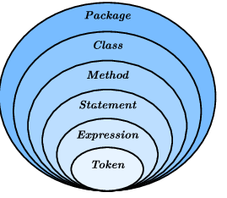


Objectives
Learn about tokens used in C++
Learn about control structures in C++
Type compatibility
Variables
Explore how to form and evaluate expressions in C++
Cast Operator
UNIT – 4 : Tokens and Expression & Control Structure

Slide 3
Content
Tokens Keywords, identifiers and constants
Basic Data Types and user defined data types and derived data types, symbolic constants
Type compatibility, Declaration of variables, Dynamic initialization,
Reference variables ,Scope Resolution Operator, Memory Management Operator,
Manipulators, Type cast operator ,Expressions and their types, implicit Conversion Operator Precedence and Control Structure
UNIT – 4 : Tokens and Expression & Control Structure

Slide 4
Tokens
The Smallest Units in a program are known as
token.
C++ has following tokens:
  Keywords
  Identifiers
  Constants
  Strings
  Operators
UNIT – 4 : Tokens and Expression & Control Structure

Slide 5
Keywords
Keywords are reserved words in programming .
Each keyword has fixed meaning and that can not be changed by user.
For Ex:
int num1;
where int is keyword indicates num1 is integer type.
UNIT – 4 : Tokens and Expression & Control Structure

Slide 6
asm | double | new | switch
auto | else | operator | template
break | enum | private | this
case | extern | protected | throw
catch | float | public | try
char | for | register | typedef
class | friend | return | union
const | goto | short | unsigned
continue | if | signed | virtual
default | inline | sizeof | void
delete | int | static | volatile
do | long | struct | while
bool | export | reinterpret_cast | typename
const_cast | false | static_cast | using
dynamic_cast | mutable | true | wchar_t
explicit | namespace | typeid
UNIT – 4 : Tokens and Expression & Control Structure

Slide 7
Identifiers And Constants
Identifier is user defined names of variables, functions,arrays, classes, etc.
They are the fundamental of any language.
Each language has its own rules for naming these identifiers.These are follow:
  Only alphabetic characters,digits and underscores are permitted.
  The name can not start with digits.
  Uppercase and lowercase letters are distinct.
  A declared keyword cannot be used as a variable name.
UNIT – 4 : Tokens and Expression & Control Structure

Slide 8
Constants
Constants refers to fixed values that do not change during the execution of program.
They include integer,character,floating point numbers and string
UNIT – 4 : Tokens and Expression & Control Structure

Slide 9
C++ Data Types
C++ data types divided mainly in three categories as follows:
  Basic data types
  User defined data types
  Derived data types
UNIT – 4 : Tokens and Expression & Control Structure

Slide 10
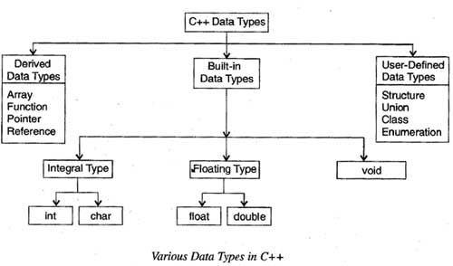
UNIT – 4 : Tokens and Expression & Control Structure

Slide 11
Basic Data
Types
TYPES | BYTES | RANGE
char | 1 | -128 to 127
unsigned char | 1 | 0 to 255
signed char | 1 | -128 to 127
int | 2 | -32768 to 32767
unsigned int | 2 | 0 to 65535
signed int | 2 | -32768 to 32767
short int | 2 | -32768 to 32767
unsigned short int | 2 | 0 to 65535
signed short int | 2 | -32768 to 32767
long int | 4 | -2147483648 to 2147483647
signed long int | 4 | -2147483648 to 2147483647
unsigned long int | 4 | 0 to 4294967295
float | 8 | 3.4E-38 to 3.4E_38
double | 10 | 1.7E-308 to 1.7E+308
long double |  | 3.4E-4932 to 1.1E+4932
UNIT – 4 : Tokens and Expression & Control Structure

Slide 12
User-defined Data Types
There are following user defined data types:
Struct
Union
Enum
class
UNIT – 4 : Tokens and Expression & Control Structure

Slide 13
Struct
A structure is a collection of simple variable
The variable in a structure can be of different type such as int,char,float,char,etc.
This is unlike the array which has all variables of
same data type.
The data items in a structure is called the member of structure.
Syntax:
struct structure_name{ declaration of data member;
};
You can access data member of stucture by using only structure variable with dot operator.
UNIT – 4 : Tokens and Expression & Control Structure

Slide 14
Exercise
Create a structure named student. Enter the student name, marks of C++, maths, Physics and DFS subjects. Calculate the average of the marks and store it in a variable named per. Make per as float variable.

Slide 15
Solution
#include<iostream> using namespace std;
struct student{
int Roll_No; char name[15];
int cPlus,maths,sql,dfs,total;
float per;
};
int main(){
struct student s; cout<<"Enter Roll No:"; cin>>s.Roll_No; cout<<"Enter Name:"; cin>>s.name;
cout<<"Enter Marks For CPlus:"; cin>>s.cPlus;
cout<<"Enter Marks For Maths:";
UNIT – 4 : Tokens and Expression & Control Structure

Slide 16
cin>>s.maths; cout<<"Enter Marks For Sql :";
cin>>s.sql;
cout<<"Enter Marks For DFS:"; cin>>s.dfs;
s.total=s.cPlus+s.maths+s.sql+s.dfs;
s.per=s.total/4;
cout<<"Your Roll No is:"<<s.Roll_No<<"\n"; cout<<"Your Name is:"<<s.name<<"\n"; cout<<"Your Total is:"<<s.total<<"\n"; cout<<"Your Percentage is:"<<s.per<<"%"<<"\n";
return 0;
}
UNIT – 4 : Tokens and Expression & Control Structure

Slide 17
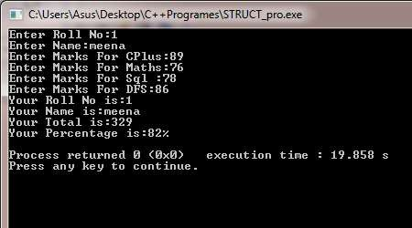
UNIT – 4 : Tokens and Expression & Control Structure

Slide 18
Union
Union is also like a structure means union is also used to storing different data types ,but the difference between structure and union is that structure consume the memory of addition of all elements of different data types but a union consume the memory that is highest among all elements.
It consume memory of highest variable and it will share the data among all other variable.
UNIT – 4 : Tokens and Expression & Control Structure

Slide 19
For example:
If a union contains variable like int, char, float then the memory will be consume of float variable because float is highest among all variable of data type.
Syntax:
union union_name
{
//union declaration
data_type member1; data_type member2;
…
};
UNIT – 4 : Tokens and Expression & Control Structure

Slide 20
Like ,
union stu{
int roll_no; char grade ;
};
//occupies 2 bytes
//occupies 1 bytes
roll_no
Byte 0
Byte 1
grade
Memory representation in union
UNIT – 4 : Tokens and Expression & Control Structure

Slide 21
Struct
Union
Define with ‘struct’ keyword.
The size of object is equal to the sum of individual size of the member object.
Members are allocated distinct memory location.
Define with ’union’ keyword.
The size of object is equal to the size of largest member object.
Members are share common memory space.
UNIT – 4 : Tokens and Expression & Control Structure

Slide 22
Enum In C++
Approach to define your own datatype is the enumerated datatype.
An enumeration type is user defined type that enable the user to define the range of values for the type.
Enumerated means all the values are listed.
An enum specifier defines the set of all the names that will be permissible values of the type.
These permissible values are called members.
Syntax:
enum [enum-type] {enum-list};
UNIT – 4 : Tokens and Expression & Control Structure

Slide 23
Name constants are used to represent the value of an enumeration for example:
enum char{a,b,c};
The default value assigned to the enumeration constant are zero-based so in above example a=0,b=1 and so on.
The user also can assign value to one or more enumeration constant, and subsequent values that are not assigned will be incremented.
For example :
enum char{a=3,b=7,c,d};
here, value of c is 8 and d is 9.
UNIT – 4 : Tokens and Expression & Control Structure

Slide 24
Exercise
Write a program to demonstrate the working of enum. Ask the user to enter the choice of fruits like apple, orange, guava, pineapple (these constants refers to the value of enum) and then print the name of the fruit.
Hint: Use enum & switch case

Slide 25
Solution
#include<iostream>
using namespace std;
int main()
{
enum Fruits{apple,orange,guava,pinapple};
Fruits myfruit; //optional
int i;
cout<<"Enter your choice:";
cin>>i;
UNIT – 4 : Tokens and Expression & Control Structure

Slide 26
switch(i)
{
case apple:
cout<<"Your first fruit is Apple."; break;
case orange:
cout<<"Your second fruit is Orange."; break;
case guava:
cout<<"Your third fruit is Guava.";
break;
case pinapple:
cout<<"Your forth fruit is Pineapples."; break;
}
return 0;
}
UNIT – 4 : Tokens and Expression & Control Structure

Slide 27
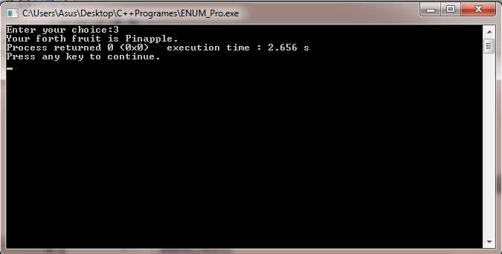
UNIT – 4 : Tokens and Expression & Control Structure

Slide 28
Inventing a Boolean type
There is no Boolean (false or true) datatype in C++; the integer values 0 and 1 are used instead.
However, it is easy to invent your own Boolean type using enum.
enum boolean {false,true}; //false=0, true=1
UNIT – 4 : Tokens and Expression & Control Structure

Slide 29
Specifying integer values
In enum specifier, the first name was given by the integer value 0, the second the value is 1, and so on.
This ordering can be altered by using an equals sign to specify a starting point other than 0.
enum suit { clubs=1,diamonds,hearts,spades};
UNIT – 4 : Tokens and Expression & Control Structure

Slide 30
Class
The class type enables us to create sophisticated use defined type.
We provide data items for the class and the operation that can be performed on the data.
Syntax:
class class_name
{
data member variables;
data member methods/functions;
};
UNIT – 4 : Tokens and Expression & Control Structure

Slide 31
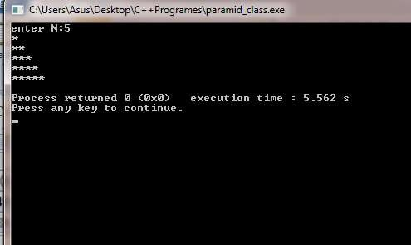
Exercise
Draw the below mentioned pyramid using the concept of class

Slide 32
Solution
#include<iostream>
using namespace std;
class Pyramid
{
int i,n,j;
public:
void getdata();
void buildpyramid();
};
void pyramid::getdata()
{
cout<<"enter N:"; cin>>n;
}
UNIT – 4 : Tokens and Expression & Control Structure

Slide 33
void piramid::buildpyramid()
{
for(i=1;i<=n;i++)
{
for(j=1;j<=i;j++)
{
cout<<"*";
}
cout<<"\n";
}
}
int main()
{
Pyramid p;
p.getdata();
p.buildpyramid();
return 0;
}
UNIT – 4 : Tokens and Expression & Control Structure

Slide 34
UNIT – 4 : Tokens and Expression & Control Structure

Slide 35
Derived Data Type
The derived data type are:
  Array
  Function
  pointer
UNIT – 4 : Tokens and Expression & Control Structure

Slide 36
Array
An array is a series of elements of the same data type placed in contiguous memory location.
Like regular variable ,an array must be declare before it is used.
Syntax:
data_type name[size];
Ex:
char name[10];
int student[10];
UNIT – 4 : Tokens and Expression & Control Structure

Slide 37
Function
A function is a group of statement that together perform a task.
Every c++ program has at least one function that is main() and programmer can define additional function.
You must define function prototype before use them.
A function prototype tells compiler the name of the function ,return type, and parameters.
UNIT – 4 : Tokens and Expression & Control Structure

Slide 38
Syntax:
return_type function_name(parameter_list);
Ex:
int max(int n1,int n2);
UNIT – 4 : Tokens and Expression & Control Structure

Slide 39
Exercise
Write a program to demonstrate the working of function in C++ to find out the maximum of 2 numbers entered by the user

Slide 40
Solution
#include<iostream> using namespace std;
int max(int n1,int n2);
//declaration
int main()
{
int n1; int n2; int a;
cout<<"Enter Number1: "<<"\n"; cin>>n1;
cout<<"Enter Number2: "<<"\n";
cin>>n2;
a=max(n1,n2);
//calling function
cout<<"max value is "<<a<<"\n";
return 0;
}
UNIT – 4 : Tokens and Expression & Control Structure

Slide 41
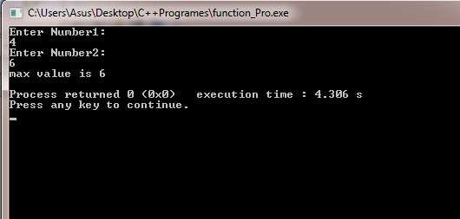
int max(int n1,int n2)
{
int result; if(n1>n2) result=n1; else result=n2;
return result;
}
UNIT – 4 : Tokens and Expression & Control Structure

Slide 42
Pointer
Pointer is basically the same as any other variable, difference about them is that instead of containing actual data they contain a pointer to the memory location where information can be found.
Basically, pointer is variable whose value is address of another variable.
Syntax:
type *var_name;
Ex:
int *p;
UNIT – 4 : Tokens and Expression & Control Structure

Slide 43
There are few operation which will do frequently with pointer is:
  We define a pointer variable.
  Assign address of variable to a pointer and
  Finally access the value at the address available in the pointer variable.
Like,
  int var=20;
  p =&var;
  int *p;
UNIT – 4 : Tokens and Expression & Control Structure

Slide 44
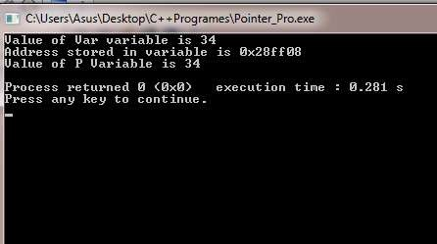
Pointer Program
#include<iostream>
using namespace std;
int main()
{
int var=34; int *p;
p=&var;
cout<<"Value of Var variable is "<<var<<"\n";
cout<<"Address stored in variable is "<<p<<"\n";
cout<<"Value of P Variable is "<<*p<<"\n"; return 0;
}
UNIT – 4 : Tokens and Expression & Control Structure

Slide 45
Symbolic Constant Type
Constant is an identifier with associated value which can not be altered by the program during execution.
You must initialize a constant when you create it, you can not assign new value later after constant is initialized.
Symbolic constant is a constant that is represented by name.
  Defining constant with ’ #define’.
  Defining constant with ’const’.
  Defining constant with ’enum’.
UNIT – 4 : Tokens and Expression & Control Structure

Slide 46
Ex:
#define pi 3.14
const max=10;
enum char{a,b,c};
UNIT – 4 : Tokens and Expression & Control Structure

Slide 47
Type Compatibility
The sizeof is a keyword but it is compile time operator that determine the size, in byte, of a variable or data type.
It can be used to get the size of classes, structure, union and any other user defined data type.
Syntax:
sizeof(data_type)
Ex:
sizeof(x) or sizeof(int)
sizeof operater will return integer value.
UNIT – 4 : Tokens and Expression & Control Structure

Slide 48
Program: Use Of Sizeof Operator
#include<iostream>
using namespace std;
int main()
{
int a,x; char b;
float c=10.02; double d;
cout<<"size of a:"<<sizeof(a)*sizeof(x)<<"\n"; cout<<"size of b:"<<sizeof(b)<<"\n"; cout<<"size of c:"<<sizeof(10.02)<<"\n"; cout<<"size of d:"<<sizeof(d)<<"\n";
return 0;
}
\*nested sizeof *\
UNIT – 4 : Tokens and Expression & Control Structure

Slide 49
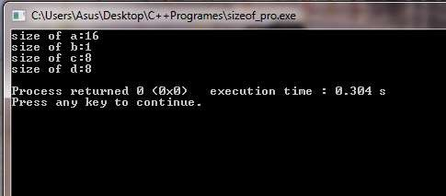
UNIT – 4 : Tokens and Expression & Control Structure

Slide 50
Variable In C++
Variable is a place to store information.
A variable is a location in your computer’s memory in which you can store a value and from which you can later retrieve the value.
This is temporary storage, when you turn the computer off these variable are lost.
Like c, in C++ all variable must be declare before we used it.
The difference is that in c, it requires to be defined at the beginning of a scope, rather C++ allow you to declaration of variable anywhere in the scope.
UNIT – 4 : Tokens and Expression & Control Structure

Slide 51
This means that a variable can be declared right at the place of its first use.
Declaration Of variable: char name[12];
int a;
float num;
If you are going to declare more than one variable having same data type, you can declare all of them in single statement by separating their identifiers with commas.
For ex:
int a,b,c;
UNIT – 4 : Tokens and Expression & Control Structure

Slide 52
At the other-end you can assign value to the variable when you declare them its called initialization.
Ex:
int a=0;
char name[]={‘h’,’e’,’l’,’l’,’o’}; char name[8]=‘computer’
UNIT – 4 : Tokens and Expression & Control Structure

Slide 53
Dynamic initialization:
The additional feature of c++ is ,to initialize the variable at run time it is called dynamic initialization.
For example:
int c= a+b;
float avg=sum/n;
UNIT – 4 : Tokens and Expression & Control Structure

Slide 54
Reference variable:
C++ references allow you to create a second name for the variable that you can use to read or modify the original data stored in that variable.
This means that when you declare a reference and assign it a variable it will allow you to treat the reference exactly as though it were the original variable for the purpose of accessing and modifying the value of the original even if the second name(reference) is located within the different scope.
Variable with different name share same data space.
UNIT – 4 : Tokens and Expression & Control Structure

Slide 55
Syntax:
data_type& ref_name= var_name;
Ex:
int a;
int& i=a;
UNIT – 4 : Tokens and Expression & Control Structure

Slide 56
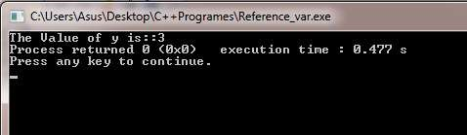
Reference Program
#include<iostream> using namespace std; int main()
{
int x[5]={1,2,3,4,5};
int& y=x[2];
cout<< "The Value of y is::" << y; return 0;
}
UNIT – 4 : Tokens and Expression & Control Structure

Slide 57
Operators In C++
All the operator in c is available in c++,but some additional operator that are not in c are:
<< Insertion operator
>> Extraction operator
:: Scope resolution operator
* Pointer to member operator
delete memory release operator
endl line feed operator
new memory allocation operator
setw field width operator
UNIT – 4 : Tokens and Expression & Control Structure

Slide 58
Scope Resolution Operator(::)
Basically variable are two types ,local variable and global variable.
The variable which are declared within a block or function, that are used only inside a function is called local variable.
The global variable are declared out side function and used anywhere in the program.
UNIT – 4 : Tokens and Expression & Control Structure

Slide 59
A situation occurs when both global and local variable name are same and we have to use global variable inside a local block or function, then it is only possible by using Scope Resolution Operator, it is used with global variable.
Syntax:
::variable_name;
A major application of the scope resolution operator is in the classes to identify the class to which a member function belongs.
UNIT – 4 : Tokens and Expression & Control Structure

Slide 60
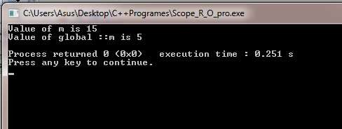
Program Using :: Operator
#include<iostream> using namespace std;
int m=5;
int main()
{
int m=15;
//global declaration
cout<<"Value of m is "<<m<<"\n"; cout<<"Value of global ::m is "<<::m<<"\n"; return 0;
}
UNIT – 4 : Tokens and Expression & Control Structure

Slide 61
Member Dereferencing Operator
The member dereferencing operator are used in class, a class contain various type of data and function as member.
The dereference operator is also known as the indirection operator.
A c++ also permit us to access the class member through pointer, so required a pointer to member operator which are,
▪
▪
::* to declare a pointer to a member class
.* to access a member using object name or
Pointer to that member.
->* to access a member using a pointer to the object and a pointer to that member.
▪
UNIT – 4 : Tokens and Expression & Control Structure

Slide 62
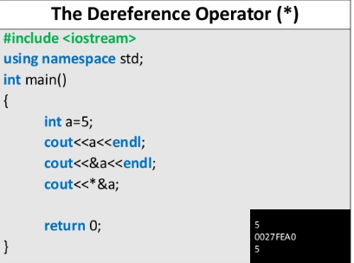
UNIT – 4 : Tokens and Expression & Control Structure

Slide 63
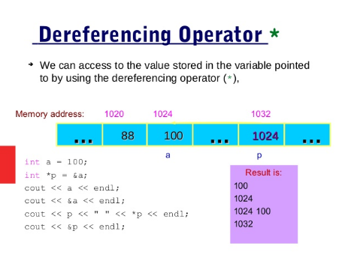
UNIT – 4 : Tokens and Expression & Control Structure

Slide 64
Memory Management Operators
C++ using two unary operators to new and delete , that perform the task of allocating and freeing the memory in better and easy way.
A new operator can be create object of any type.
Syntax:
pointer_variable= new data_type;
Ex:
int *p=new int;
A delete operator deallocate pointer variable.
Syntax:
delete pointer_variable;
Ex:
delete p;
UNIT – 4 : Tokens and Expression & Control Structure

Slide 65
You can also create space for any data type including user-defined data type like array, structure, classes ,etc.
Syntax :
pointer_variable=new data_type[size];
Ex:
int *p=new int[100];
Delete array element.
Syntax:
delete [] pointer_variable;
Ex:
delete []p;
UNIT – 4 : Tokens and Expression & Control Structure

Slide 66
Program Using New And
Delete Operator
#include<iostream> using namespace std; int main()
{
int *a=new int; int *b =new int;
int *sum= new int;
cout<<"Enter value for a and b:"<<"\n"; cin>>*a>>*b;
*sum=*a+*b;
cout<<"Sum of a and b is: "<<*sum; delete a;
delete b; return 0;
}
UNIT – 4 : Tokens and Expression & Control Structure

Slide 67
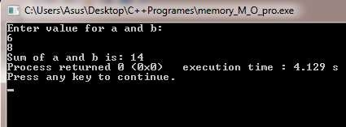
}
UNIT – 4 : Tokens and Expression & Control Structure

Slide 68
Manipulators
C++ provides the operator called manipulator for formatting the output or manipulate the data in the way programmers wants to display it.
Most commonly used manipulators are:
  endl
  setw()
endl: it causes a linefeed to be inserted into the stream. It has the same effect as sending a single new line(“\n”) character.
setw() is used to provide the field width for the value and display them right-justified.
UNIT – 4 : Tokens and Expression & Control Structure

Slide 69
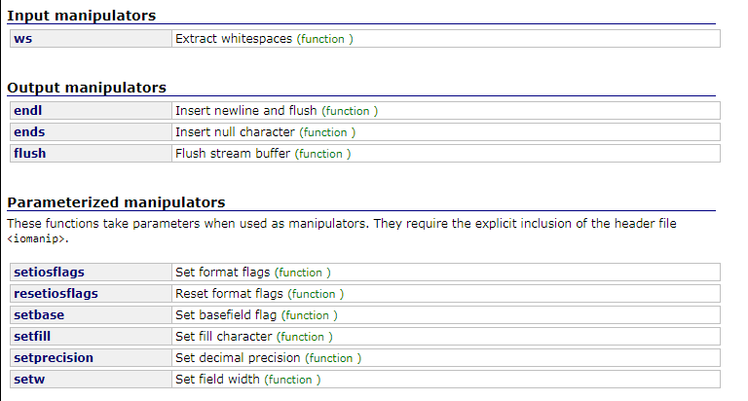
UNIT – 4 : Tokens and Expression & Control Structure

Slide 70
Like,
int x=22;
cout<<setw(5)<<x;
 |  |  | 2 | 2
The <iomanip> header file provide rich set of manipulators.
UNIT – 4 : Tokens and Expression & Control Structure

Slide 71
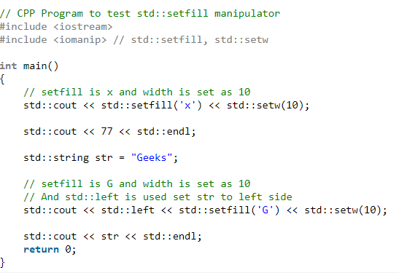
UNIT – 4 : Tokens and Expression & Control Structure

Slide 72

Output
UNIT – 4 : Tokens and Expression & Control Structure

Slide 73
Manipulator Program
#include<iostream> #include<iomanip> using namespace std;
int main()
{
int roll_no=2;
char name[]="Heer"; int age=19;
cout<<"Roll number is :"<<setw(5)<<roll_no<<endl; cout<<"Name is :"<<setw(5)<<name<<endl; cout<<"Age is :"<<setw(5)<<age<<endl;
}
UNIT – 4 : Tokens and Expression & Control Structure

Slide 74
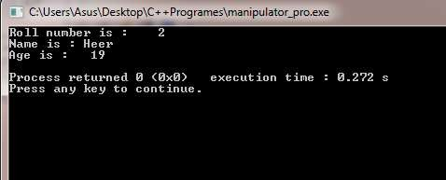
Manipulator Program
UNIT – 4 : Tokens and Expression & Control Structure

Slide 75
Type Conversion
Categorized in
  Automatic conversions:
    When two operands of different tpes are encountered in the same expression, the lower-type variable is converted to the type of higher-type variable.
  Casts:
    This is specified by the programmer, as opposed to the automatic data conversions. This is sometimes called coercion; the data is coerced into becoming another type
UNIT – 4 : Tokens and Expression & Control Structure

Slide 76
Type Casting
While evaluating an expression if both operands for an operator are not of same data type, then using implicit conversion rule c++ convert smaller type to wider type.
For example, if two operands are respectively int and float type, then int is converted into a float ad then operation is performed.
Many times implicit conversion cause the problem and we do not get proper result.
UNIT – 4 : Tokens and Expression & Control Structure

Slide 77
For that, like c, c++ also uses explicit type casting with the type cast operator in two different style as follow:
Syntax:
(type_name) expression;
type_name (expression);
Ex:
average=(float) sum/n;
average=float(sum)/n;
UNIT – 4 : Tokens and Expression & Control Structure

Slide 78
Expression And Their Types
An expression is combination of operators,constants and variables arranged as per the rule of language.
It may also include function calls which return values.
An expression may consist of one or more operands and zero or more operators to produce a value.
UNIT – 4 : Tokens and Expression & Control Structure

Slide 79
Expression may consist of following seven types:
  Constant expressions
  Integral expressions
  Float expressions
  Pointer expressions
  Relational expressions
  Logical expressions
  Bitwise expressions
UNIT – 4 : Tokens and Expression & Control Structure

Slide 80
Constant expression:
It consist of only constant value.
Ex: 20 + 5 / 20;
Integral expression:
Integral expressions are those which produce integer results after implementing all the automatic and implicit type conversions.
Ex: m * n – 5; //m and n are integer
5 + int(2.0);
Float expression:
Floating expression are those which, after all conversations, produce floating point results.
Ex: 5 + float(10);
x * y / 10; //x and y are floating point
UNIT – 4 : Tokens and Expression & Control Structure

Slide 81
Pointer expression:
Pointer expression are produce address values.
Ex: &m;
ptr; //m is variable and ptr is pointer
Relational expression:
Relational expressions yield results of type bool which takes a value true or false.
Also known as boolean expression.
Ex: x <= y;
a+b = c+d;
If arithmetic expression are used either side of relational operator, they will be evaluated first then the results compared.
UNIT – 4 : Tokens and Expression & Control Structure

Slide 82
Logical expression
Logical expression combine two or more relational expression and produces bool type result.
Ex: a>b && x==10;
x==10 || y==5;
Bitwise expression
Bitwise expressions are used to manipulate data at bit
level. They are basically used for testing or shifting bits.
Ex: x<<3 y>>1
// shift three bit position to left
// shift one bit position to right
UNIT – 4 : Tokens and Expression & Control Structure

Slide 83
Special Assignment Expressions
Chained assignment:
x = (y=10); or x = y = 10;
In above expression the 10 value is first assign to y and
then to x.
Chained expression is not used to initialization at the time of declaration .
Like ,
float a=b=12.34; is wrong, instead of this we may write , float a = 12.34, b= 12.34; is correct.
UNIT – 4 : Tokens and Expression & Control Structure

Slide 84
Embedded assignment:
x = (y =50) +10;
where y=50 is an assignment expression known as embedded assignment.
here, value 50 is assigned to y and then the result (50 + 10 = 60) is assigned to x.
like, y=50;
x = y + 10;
Compound assignment:
Compound assignment operator (+=)is a combination of the assignment operator with a binary operator.
Ex: x=x+10 may be written as , x +=10;
UNIT – 4 : Tokens and Expression & Control Structure

Slide 85
Implicit Conversion
Whenever data type are mixed in expression, c++ perform conversions automatically. This process is known as implicit conversion.
If the operand type differ than the compiler converts one of them to match with the other using the rule that the “smaller” type is converted to the “wider” type.
For example, if one operand is an int and other is float , the int is converted into float because float is wider than int.
Whenever a char and short int appears in expression it is converted to an int.
UNIT – 4 : Tokens and Expression & Control Structure

Slide 86
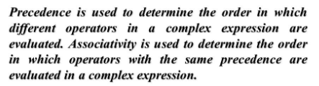
Precedence & Associativity
UNIT – 4 : Tokens and Expression & Control Structure

Slide 87
OPERATOR PRECEDENCE AND ASSOCIATIVITY
precedence | operators | description | associativity
1 | :: | Scope resolution operator | Left-to-right
2 | ++ -- type() type{ } ( ) [ ] . -> | Suffix/postfix increment decrement Function style Type cast Function call Array subscripting Element selection by Reference Element selection through pointer C
alai
UNIT – 4 : Tokens and Expression & Control Structure

Slide 88
precedence | operators | description | associativity
 | ++ - - | Prefix increment and
 |  | decrement
 | + - | Unary plus and minus
 |  | logical NOT and
 | ! ~ | bitwise NOT
 |  | C-style type cast
 | (type)
 |  | Indirection
3 | * | (dereference) | Right-to-left
 |  | Address –of
 | &
 |  | Sizeof
 | sizeof | Dynamic memory
 | new, new[] | allocation
 |  | Dynamic memory
 | delete , | deallocation
 | delete[]
UNIT – 4 : Tokens and Expression & Control Structure

Slide 89
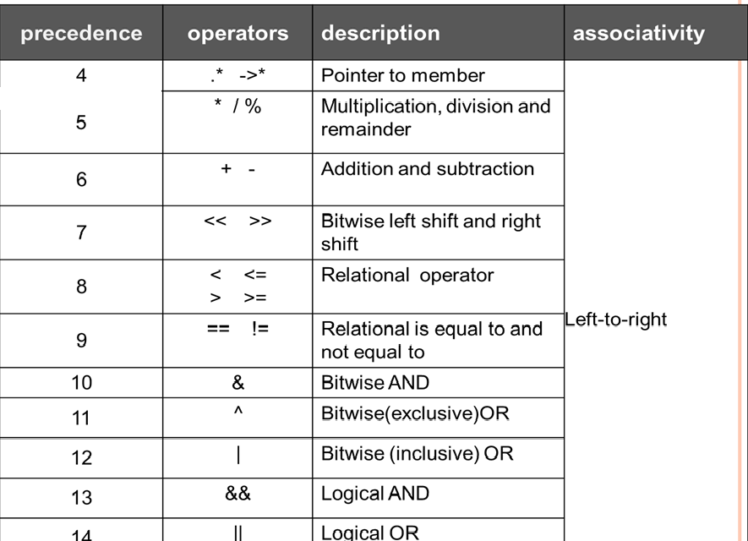
UNIT – 4 : Tokens and Expression & Control Structure

Slide 90
precedence | operators | description | associativity
 | ?: | Ternary operator
 | throw | Throw operator
 | = | Direct assignment
 |  | operator
 | += -= | Assignment by sum
15 |  | and difference | Right-to-left
 | *= /= %= | Assignment by product
 |  | quotient, and
 |  | remainder
 | <<= >>= | Assignment by left shift
 |  | and right shift
 | &= ^= |= | Assignment by bitwise
 |  | AND XOR and OR
16 | , | comma | Left-to-right
UNIT – 4 : Tokens and Expression & Control Structure

Slide 91
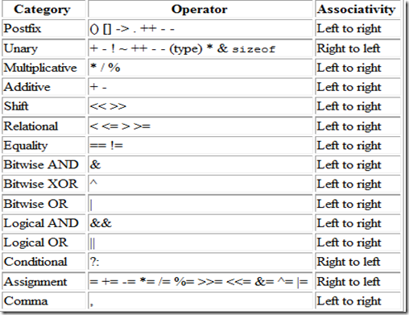
UNIT – 4 : Tokens and Expression & Control Structure

Slide 92
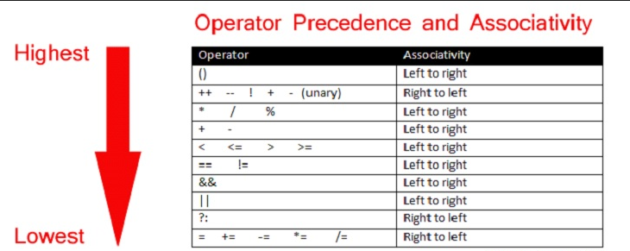
UNIT – 4 : Tokens and Expression & Control Structure

Slide 93
Control Structure
Like c ,c++ also provide same control structure as follows:
  if statement
  if-else statement
  switch statement
  do-while statement
  while statement
  for statement
UNIT – 4 : Tokens and Expression & Control Structure

Slide 94
If statement:
syntax:
if (expression is true)
{
action-1;
}
else
{
action-2;
}
if(a>b)
{
cout<<“a is max”;
}
else
{
cout<<“b is max”;
}
UNIT – 4 : Tokens and Expression & Control Structure

Slide 95
Switch statement:
switch(expression)
switch(character)
{
case ‘m’:
cout<<“male candidate”; break;
case ‘f’:
cout<<“female candidate”;
break; default:
cout<<“invalid gender code”;
}
{
case1:
action1; break;
case2:
action2;
break;
… default:
actionN;
}
UNIT – 4 : Tokens and Expression & Control Structure

Slide 96
While statement:
syntax:
while(condition is true)
{
action1;
}
while(i>5)
{
cout<<“number of class:”; i++;
}
UNIT – 4 : Tokens and Expression & Control Structure

Slide 97
Do-while statement:
syntax: do
{
action1;
}
while(condition is true);
i=0;
do
{
cout<<i<<“\n”; i++;
}
while(i<5);
UNIT – 4 : Tokens and Expression & Control Structure

Slide 98
For statement:
syntax: for(initial_value; condition;
increment/decrement)
{
action1;
}
for(int i=0;i<=5;i++)
{
cout<<i<<“\n”;
}
UNIT – 4 : Tokens and Expression & Control Structure

Slide 99
Other Control Statements
The break statement
The continue statement
The goto statement
UNIT – 4 : Tokens and Expression & Control Structure

Slide 100
Review Questions
Answer the following questions :
Describe data types in C++ in Details.
Explain public, private and protected access specifiers and show their visibility when they are inherited as public, private and protected.
Differentiate entry-controlled loop and exit-controlled loop.
UNIT – 4 : Tokens and Expression & Control Structure

Slide 101

Multiple Choice Questions
1. C++ statements that allow programmers to specifies that next statement to be executed may be other than next one in a sequence, is called as
A. Transfer of control
B. Transfer of statements
C. Transfer of program
2. C++ control structures are combined in
  A. Control-structure stacking
  B. Control-structure nesting
  C. Control-structure flow
  D. Both A and B
3. Which one is not a valid identifier?
A. rdd2
B. x (5)
C. _DATE_
D. A3O
4. In C++ a name that is assigned by a user for a program elements such as variable, type, class, function or namespaces is called
A.Operators
B.Identifier
C.Literals
D.All of These
UNIT – 4 : Tokens and Expression & Control Structure

Slide 102
MCQ Answer
1. A
2. D
3. B
4. B
UNIT – 4 : Tokens and Expression & Control Structure

Slide 103






Presentation Prepared By:
  Contact us:
  dweepnagarg.ce@charusat.ac.in
  parthgoel.ce@charusat.ac.in
  hardikjayswal.it@charusat.ac.in
  dipakramoliya.ce@charusat.ac.in
  krishnapatel.ce@charusat.ac.in
  khushipatel.ce@charusat.ac.in
  Ms. Krishna Patel
  Ms. Dweepna Garg
  Subject Coordinator
Subject Teachers:
  Mr. Parth Goel
  https://parthgoelblog.wordpress.com
Mr. Hardik Jayswal
  Ms. Khushi Patel
Devang Patel Institute of Advance Technology and Research

